Slide 1
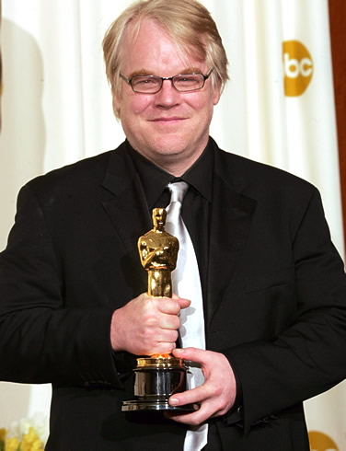
The Rise and Fall of
Philip Seymour Hoffman

Slide 2
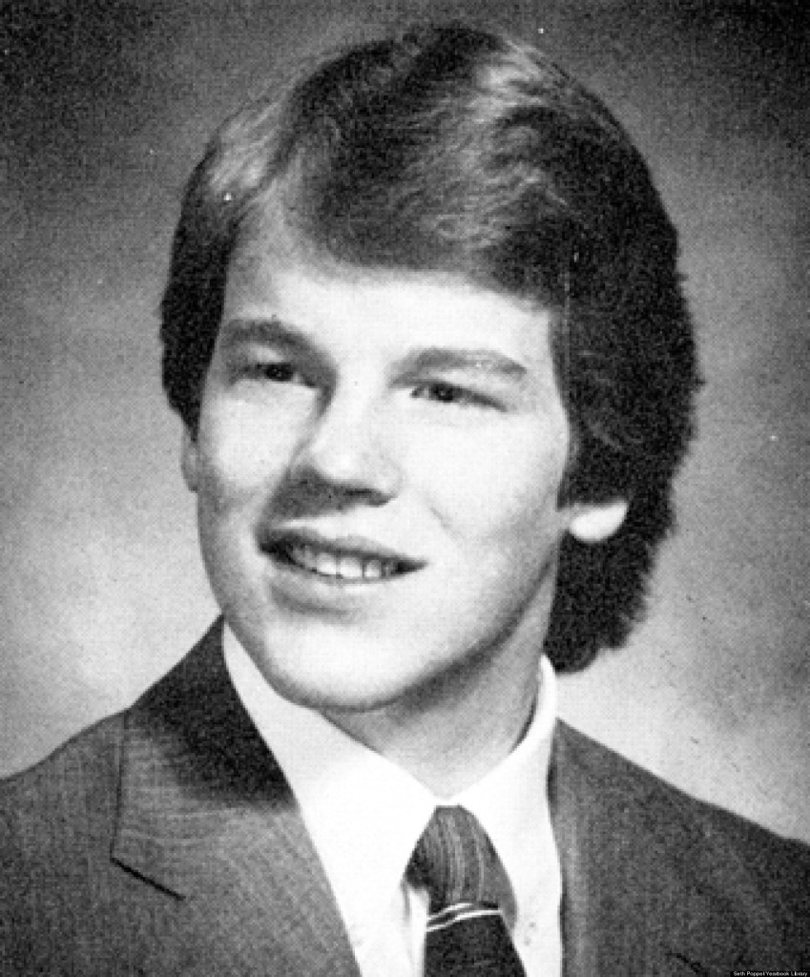
Very Early Life
Philip Hoffman was born on July 23, 1967 in Fairport NY
His mother was an elementary school teacher
His father worked for
the Xerox Corporation
He had three siblings

Slide 3
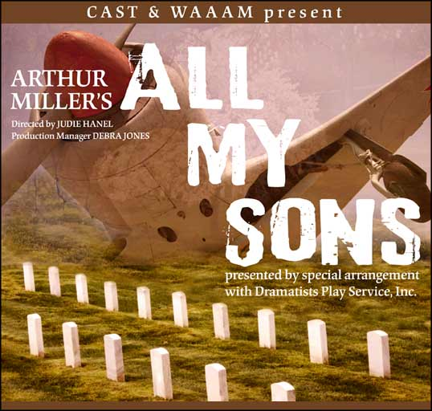
Not as Early, Life
When he was nine years old, his parents got divorced.
He was then, as a result, primarily raised by his mother, who loved acting.
At age 12 he saw a stage production of Arthur Miller’s All My Sons, which sparked his love for acting.
"I was changed—permanently changed—by that experience. It was like a miracle to me", was how he described the experience in 2008.

Slide 4
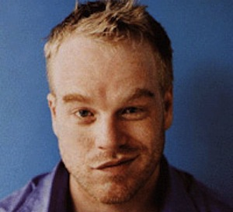
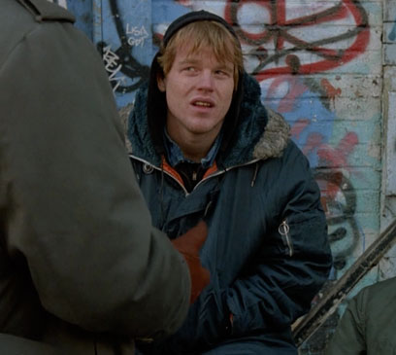
Early 1990’s Life
He joined a drama club, and applied for several drama degrees.
He attended New York University’s Tisch School of the Arts.
He made his first screen debut in 1991 in a Law & Order episode: “The Violence of Summer.”
Four years later, he checked himself into rehab because he was concerned for his life.
Began to abuse Prescription Painkillers and heroin.

Slide 5
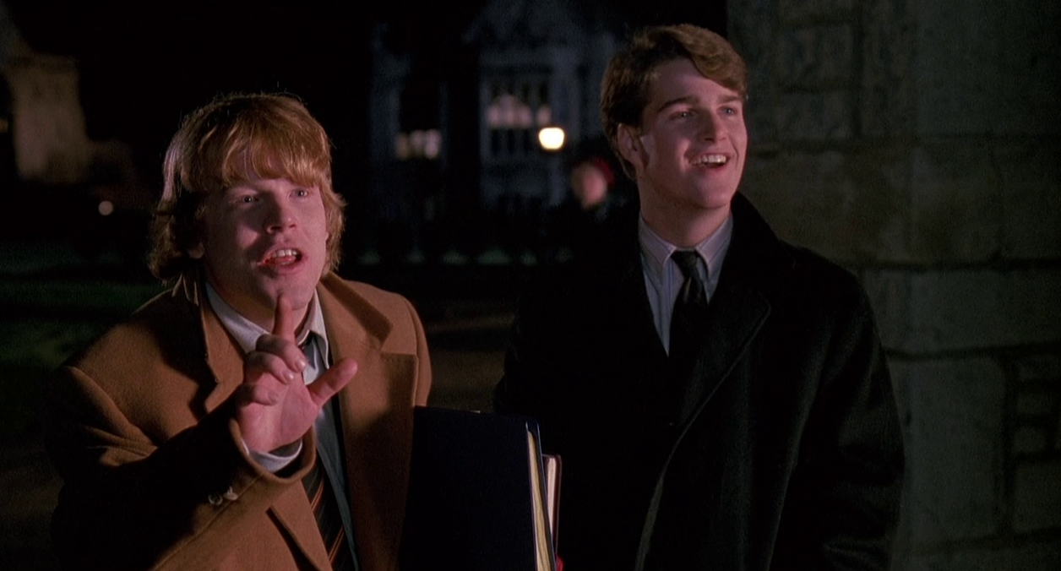
Late 1990’s Life
His first film debut came shortly after when he was in Triple Bogey on a Par Five Hole.
He adopted his grandfather’s name: Seymour, to avoid confusion with an actor of the same name.
After that, he was in more films such as Scent of a Woman where he finally got noticed. Looking back, Hoffman said “If I hadn't gotten into that film, I wouldn't be where I am today."

Slide 6
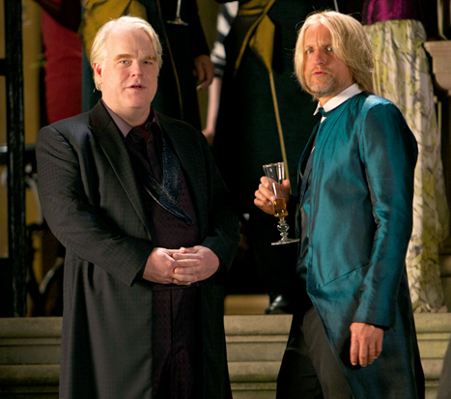
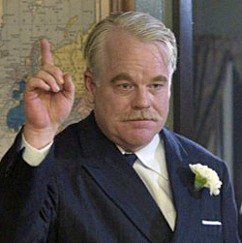
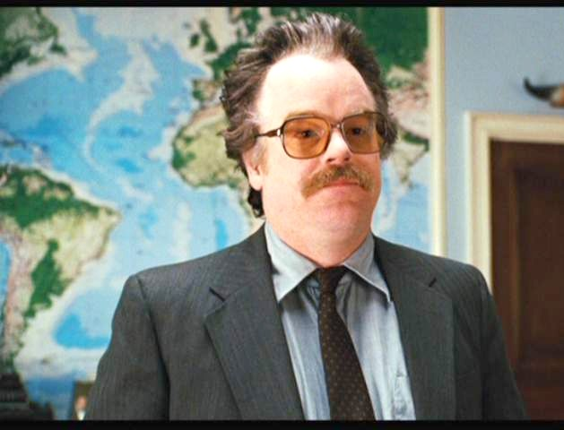
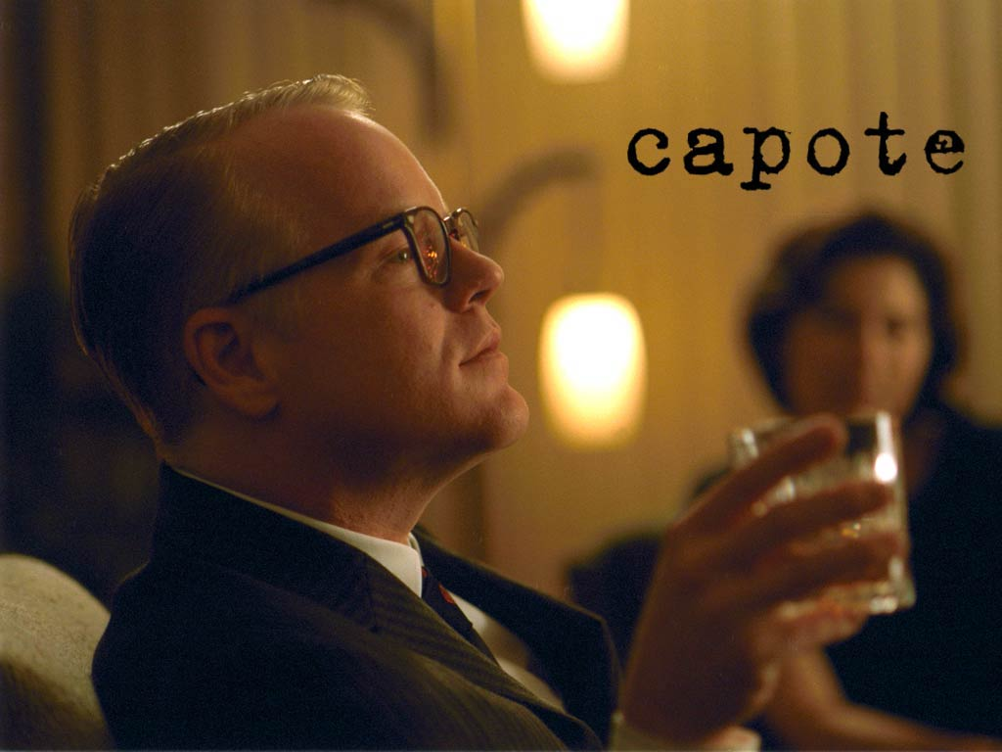
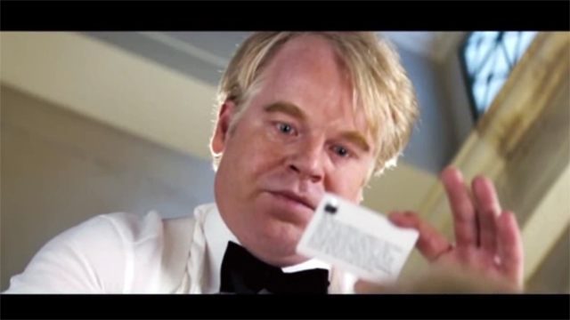
2005-2013 (Professional Actor)
The High Point in Hoffman’s Career
After 23 years of staying clean, he relapsed in May of 2012

Slide 7
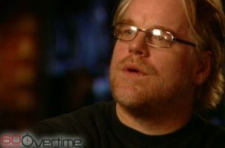
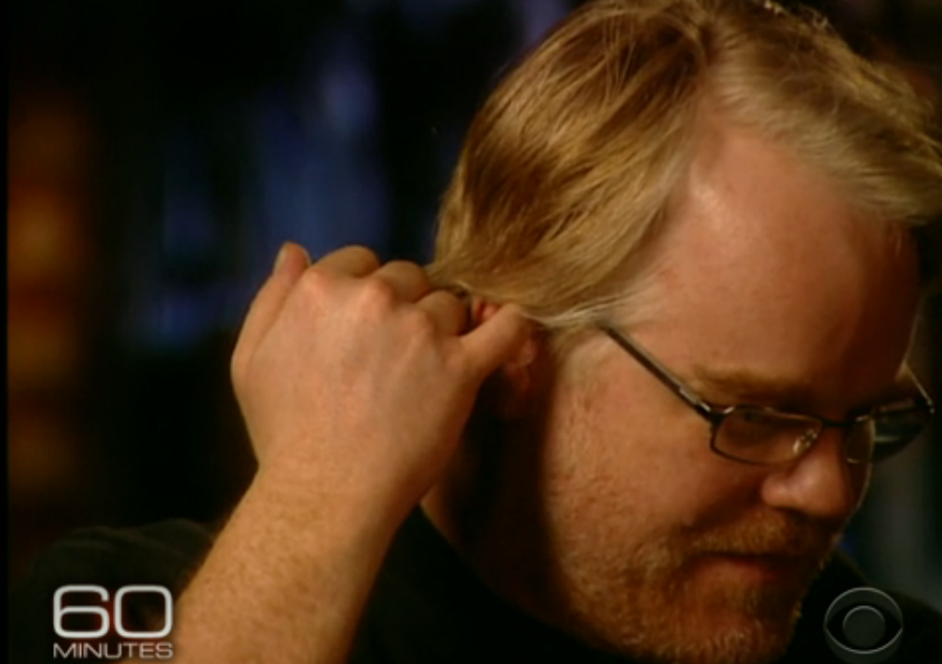
May 2012
Hoffman once again checked himself into rehab.
Only stayed 10 days due to a movie shooting in Europe.
Spoke on 60 Minuets and conveyed the image that his addiction was helped, and under control

Slide 8
60 minutes

Slide 9
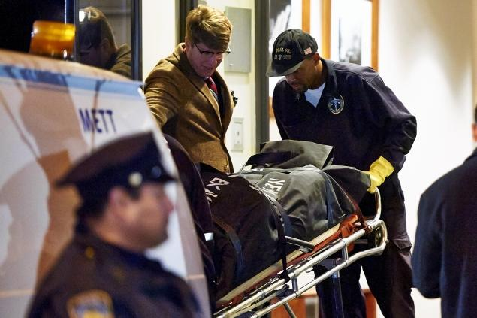
February 2nd 2014
Philip Seymour Hoffman was found dead in the bathroom of his apartment.
There was a hypodermic needle in his arm and envelopes containing heroin near his corpse.

Slide 10
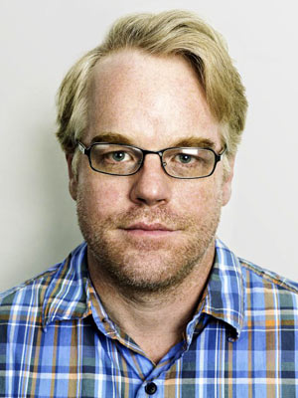
Addiction Analysis
Starting cause: I think that the professional stress of competing with all other aspiring actors caused him to begin abusing drugs.
-He knew he had to make an impression then, or he would never make it.
-He probably saw it as a means of emotional escape.

Slide 11
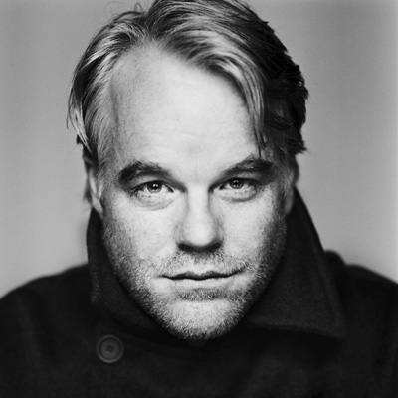
Addiction Analysis p2
Sociological: His professional environment caused him to turn to drugs.
Psychological: He may have thought he was a better actor when he was on drugs, and he probably developed a mental dependency.

Slide 12
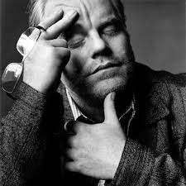
Alternate Endings
Perhaps if Philip had more family support, or had attended a longer duration of rehab towards the end of his life, he may still be alive.

Slide 13
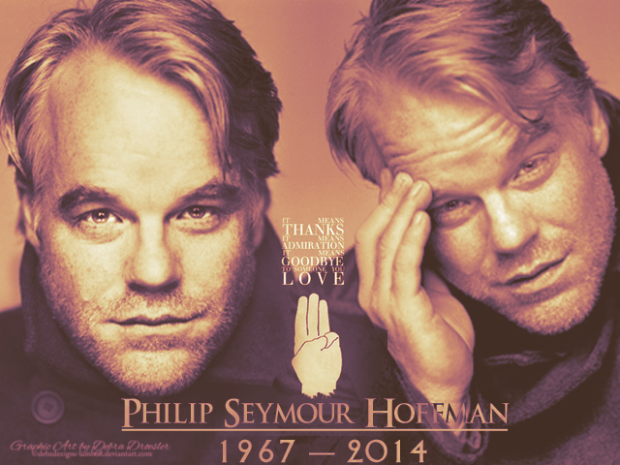
Conclusion
Philip Seymour Hoffman's eerie presence in MockingJay will serve as a reminder that he could still be alive.
Philip Seymour Hoffman was a great actor, he will be missed.

Slide 14
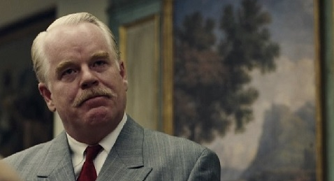
I used stuff from:
http://en.wikipedia.org/wiki/Philip_Seymour_Hoffman
http://www.imdb.com/name/nm0000450/

